Slide 1

The League of Women Voters
United States, Virginia and
Prince William Area
Who are we, what do we do?

Slide 2
A Brief Overview of the Suffrage Movement
1800s – 1917
1848 – Seneca Falls Convention calls for women’s suffrage, suffragists begin years of working for women’s right to vote
June-Dec 1917 - Lorton – 168 women “Silent Sentinels” incarcerated. Nov. 14, “Night of Terror” – Iron Jawed Angels

Slide 3
1920s-1940s
1920 - Carrie Chapman Catt founds League of Women Voters
1920 - 19th Amendment ratified, giving women the right to vote after a 72-year struggle
1920s- Eleanor Roosevelt, VP of League for legislative affairs, monitors Congressional actions
1940s – Help to establish UN, World Bank, NATO, and the Marshall Plan

Slide 4
1960s-1990s
1960s - Voting rights, education, housing, employment
Environmental issues - water and air pollution, water and waste management, energy, and land use, Clean Air and Clean Water Acts
1970s – League sponsors first televised presidential debates
1970s - Civil and human rights - ratification of the Equal Rights Amendment - almost
1990s– “Motor Voter” – National Voter Registration Act,
Constitutional right of individuals to make reproductive choices – so far

Slide 5
How has the League Changed in the Past 100 Years?
Then
Equal Suffrage League of Virginia founded in 1909
Virginia League of Women Voters founded in 1920
Now
Name changed to League of Women Voters of Viginia in 1946, as national organization restructured
Much more than the name change was the attitude change….

Slide 6
How has the League Changed in the Past 100 Years?
Then
(1940’s): Membership in the Richmond League was by invitation only sent out on engraved cards. (No women of color were invited.) Arlington/Alexandria December,1945 minutes,”...the question of admitting colored members to the Arlington/Alexandria LWV was considered. Because our local League is new and not as yet well established, the Board concluded that it would be unwise at this time to invite colored women to be members.”

Slide 7
How has the League Changed in the Past 100 Years?
Now
Membership in the League of Women Voters, the most respected and effective grassroots organization in the country, is open to men and women of all ages.
The League of the Prince William Area is diverse, open to all. Diversity, equity, and inclusion are central to our current and future success in engaging all individuals, households, communities, and policy makers in creating a more perfect democracy.

Slide 8
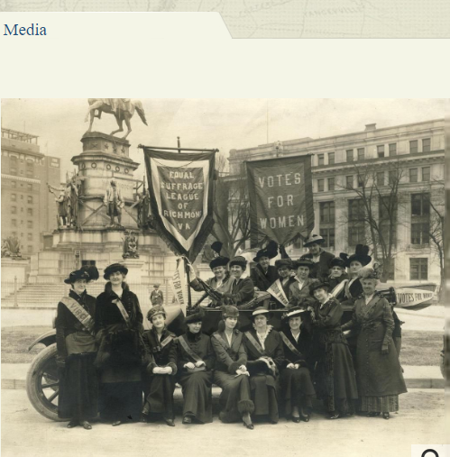
How has the League Changed in the Past 100 Years?
Then
Adele Clark and her artist friends (after organizing the ESL on November 20, 1909) had easels on the street corners in Richmond to sketch and gather crowds to start conversations about suffrage.

Slide 9
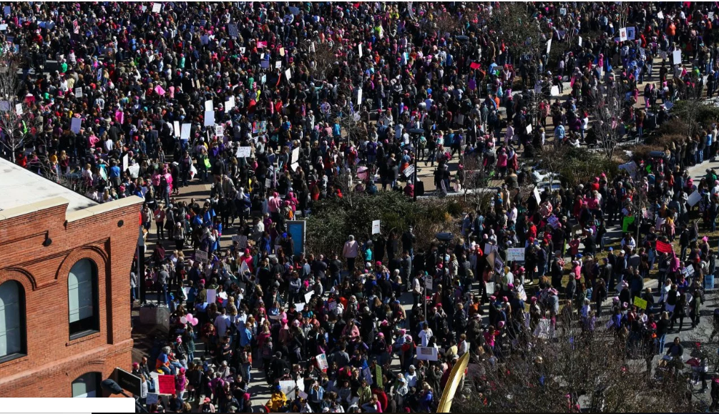
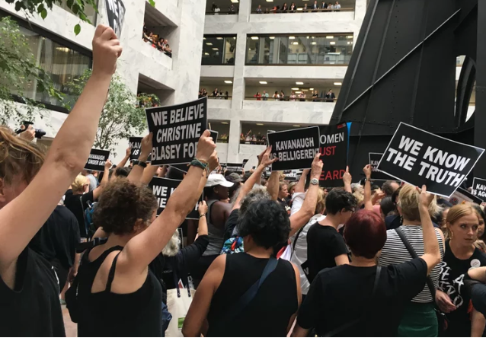
How has the League Changed in the Past 100 Years?
Now
In 2019, women gather on the streets of D.C. and on the steps of SCOTUS
We are more openly “opinionated”, less likely to want to be seen as “ladylike”.

Slide 10
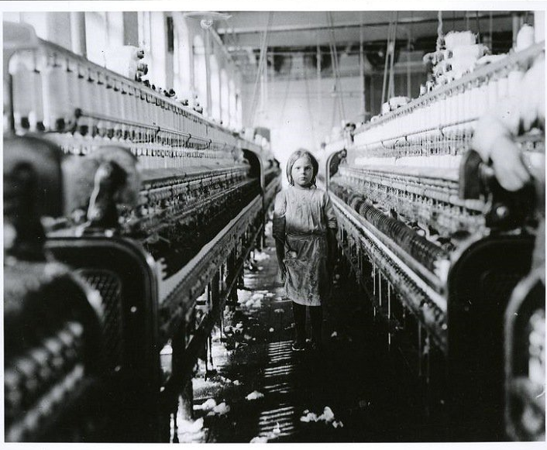
How has the League Changed in the Past 100 Years?
Then – The First Issue
1909: Child labor issues after learning of children who worked in cotton mills were dying at ages 8 to 12 because of lint in mills.
Now

Slide 11
How has the League Changed in the Past 100 Years?
Now – Children’s Issues
Child Care - Support programs and policies to expand the supply of affordable, quality child care for all who need it
Early Intervention for Children at Risk - Support policies and programs that promote the well-being, development and safety of all children
Violence Prevention - Support violence prevention programs in communities
And more - Bullying, safety at schools, social media exploitation,...

Slide 12
How has the League Changed in the Past 100 Years?
Then
In 1909, the very idea of women voting contradicted the traditional role of men and women in society. More critical in Virginia, where the ESL worked for a state suffrage amendment, was the fear that giving the vote to women would lead to black women voting which would upset the balance of power in Virginia and throughout the South.

Slide 13
How has the League Changed in the Past 100 Years?
Now
Guess they were right!
1924 – Sarah Lee Fain and Helen T. Henderson elected to the House of Delegates
1979 – 1st woman Senator elected: Eva F. Scott
1983 – Yvonne B. Miller, the first African-American woman to be elected to the House of Delegates. Four years later, she was elected to the Virginia Senate, and was consistently reelected after that, and died in office in 2012.
2019: Ten (10) women Senators, including women of color

Slide 14
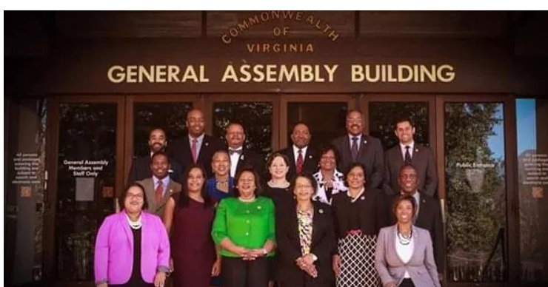
How has the League Changed in the Past 100 Years?
Now
The Virginia Legislative Black Caucus

Slide 15
How has the League Changed in the Past 100 Years?
Then
(1950s): Most white Virginia women supported school segregation
Now
The African-American heroine of desegregation, Barbara Johns, is honored with a statue on Capitol Square in Richmond. (See LWV-VA Positions re equity in education.)

Slide 16
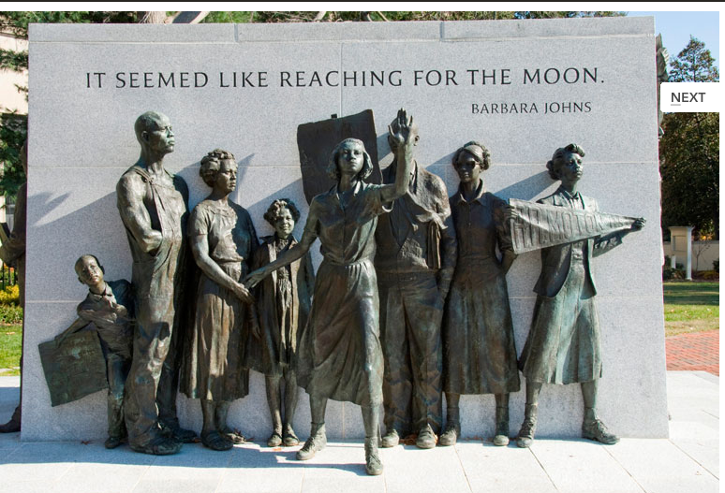
How has the League Changed in the Past 100 Years?

Slide 17
How has the League Changed in the Past 100 Years?
Then
1968: Commission to revise Virginia’s Constitution. Its proposed bill of rights prohibited the state government from discriminating on the basis of religion, race, color, and national origin, but not....... sex. The “charming lady members of the General Assembly caught this fact,” a Senator reported during debate. After discussion “sex” was included in the new constitution adopted in 1971.

Slide 18
How has the League Changed in the Past 100 Years?
Now
Is the Virginia Constitution adequate to prohibit sex discrimination?
Ratification of the Equal Rights Amendment failed in the House of Delegates this past session (2019).

Slide 19
How has the League Changed in the Past 100 Years?
Then
Poll tax payment was required to register to vote
1960s
Poll tax for federal elections banned by U.S. Constitution in 1964; SCOTUS banned Virginia’s poll tax for state elections in 1965

Slide 20
How has the League Changed in the Past 100 Years?
The League celebrated the demise of the poll tax! Massive voter registration drives were mounted by the League and other groups – Albemarle and Fairfax Leagues ran “Votes-Wagons” and encouraged huge increases in voter registration
The League continued support for better absentee ballot laws and the revision and simplification of voting laws, including a uniform method of voter identification at the polls

Slide 21
League Pamphlet - 1919
The Aims of the League
The organization has three purposes:
to foster education in citizenship,
to promote forums and public discussion of civic reforms and
to support needed legislation

Slide 22
LWV-VA 2019
MISSION STATEMENT: Empowering Voters. Defending Democracy.
VISION STATEMENT: We envision a democracy where every person has the desire, the right, the knowledge and the confidence to participate.
VALUE STATEMENT: We believe in the power of women to create a more perfect democracy.

Slide 23
What is the Prince William League Doing?
We are busy! We -
  Participate in voter registration and education opportunities
  Organize candidate forums
  Partner with other groups to present programs (DST, PWC100)
  Visit Jails to explain Restoration of Rights
  Attend Electoral Board meetings, BOCS meetings
  Organized and participated in several Opioid Awareness programs, partnering with other organizations
  Organized ERA program with local delegates attending
  Developed a task force to study School Choice – 2017-18

Slide 24
Today’s Issues for the LWV-VA
Behavioral Health
Education/School Choice
Felon Voting Rights
Firearm Safety
Fracking, Uranium & other Extractive Industries
Human Trafficking
Redistricting in Virginia
Voter Advocacy
Women’s Issues: Women’s rights and the VA Code
Most of these are active Facebook Groups.

Slide 25
Today’s Issues for LWV-PWA
Women’s Issues – ERA, human trafficking, reproductive rights, sexual harassment
Redistricting/Gerrymandering
Election Issues
  Voting rights, voter suppression
Environmental Issues – fracking, pipeline, coal ash, climate change
Immigration
Firearm Safety
Ranked Choice voting
All of these issues are supported by the US and VA Leagues

Slide 26
What is the Prince William League Doing?
We study and learn the issues – and then we take action and advocate
Action and Advocacy are based on the League positions, or platforms. As League members we must be nonpartisan. As individuals (not as members) we are able to choose sides.
Statewide positions we have taken part in:
  Fracking study and consensus process
  School Choice Task Force – updating a state position
  Redistricting – community education and advocating for change with our legislators, working with OneVirginia2021
  Advocacy and lobbying for passage of the ERA

Slide 27
How do we learn about the Issues?
League workshops
League position papers on issues
General meetings with speakers who are advocates for issues that we support
Study groups that research the issues and report findings
Smaller groups that base book discussions or movie presentations on a particular issue. Latest issues: opioid addiction in PWC, human trafficking
Candidate Forums – always non-partisan, learn what the candidates stand for – or against
Our “Observer Corps” –attend government meetings

Slide 28
What is the Prince William League Doing?
We study, learn, take action and advocate
Local action and advocacy based on the National and State positions:
Lobbying PW BOS to support No Excuse Absentee Voting by setting it as one of its legislative priorities. They did.
Lobbying PW BOS to support ERA resolution. They did not.
Restoration of Rights education for inmates
Ban the Box advocacy – approved by BOS for county agencies
Homeless issues, school discipline issues – supported community education on these topics, worked with community groups

Slide 29
What is the Prince William League Doing?
Voting and Voter Education
LWV-PWA has a long history of working to educate voters and encouraging people to register:
Voter registration drives with Electoral Board confidence*
They Represent You (TRY) – We create brochures with lists of PWC representatives and contact information
TOP TEN – lots of information on a small page all about elections
Candidate debates, often with partner organizations
Electoral board meetings - “Observer Corps”
*Members wishing to take part in Voter Registration Drives must take a course given by the VA Board of Elections and register with them each year.

Slide 30
What can you do as a Member of the League?
Get Informed and Speak Out
Promote voter registration and education – through high schools, community colleges, others
Provide community Voter Service –distribute They Represent You (TRY) brochures to community
Speak out on local, state and national issues
Attend meetings and discuss issues
Write letters to the editor, advocating for League position on the issues
  You must write as an independent citizen, only the President can speak for the League.

Slide 31
What can you do?
Be Active – Engage in Advocacy
As a Member of the League of Women Voters
Know who your representatives are and where they stand on the issues
Attend the Women’s Legislative Round Table in Richmond, to get informed on upcoming issues, and,
Advocate for your positions to your representatives in PWC, VA or DC
Take Action when Action Alerts come out from the State League

Slide 32
What can you do?
Go Local
Register to vote and Vote!
Participate in voter registration in high schools or civic events
Volunteer to take voters to register, or to absentee voting, or to the polls on Election Day
Attend School Board, Board of Supervisors or the Electoral Board meetings – learn what’s going on, report back
Take part in activities sponsored by our PWA League

Slide 33
1920 to 2020
100 years - how far have we come?
Would our early sisters say that we have worked hard enough, or point to what is left to accomplish?
How will we mark this anniversary?
What will we do to honor all of those members who worked so hard to get us where we are today?

Slide 34
“Democracy Dies in Darkness”
(Washington Post masthead)
Let’s continue to keep the lights on.

