Slide 1

The League of Women Voters
United States, Virginia and
Prince William Area
Who are we, what do we do?

Slide 2
1800s – 1930s
1848 – Seneca Falls Convention calls for women’s suffrage, suffragists begin years of working for women’s right to vote
June-Dec 1917 - Lorton – 168 women “Silent Sentinels” incarcerated. Nov. 14, “Night of Terror” – Iron Jawed Angels
1920 - Carrie Chapman Catt founds League of Women Voters
1920 - 19th Amendment ratified, giving women the right to vote after a 72-year struggle
1920s- Eleanor Roosevelt, VP of League for legislative affairs, monitors Congressional actions

Slide 3
1940s-2000s
1940s – Help to establish UN, World Bank, NATO, and the Marshall Plan
1960s - Voting rights, education, housing, employment
Environmental issues - water and air pollution, water and waste management, energy, and land use, Clean Air and Clean Water Acts
1970s – League sponsors first televised presidential debates
1970s - Civil and human rights - ratification of the Equal Rights Amendment - almost
1990s– “Motor Voter” – National Voter Registration Act,
Constitutional right of individuals to make reproductive choices – so far

Slide 4
How has the League Changed in the Past 100 Years?
Then
Equal Suffrage League of Virginia
Now
League of Women Voters
Much more than the name change was the attitude change….

Slide 5
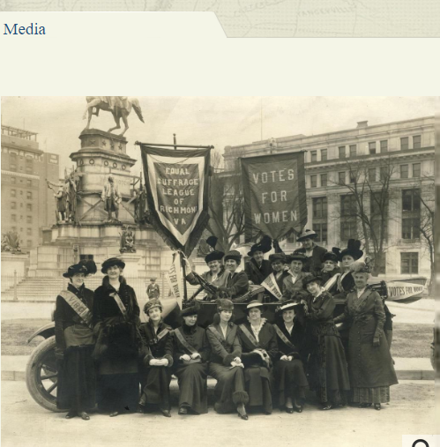
How has the League Changed in the Past 100 Years?
Then
Adele Clark and her artist friends (after organizing the ESL on November 20, 1909) had easels on the street corners in Richmond to sketch and gather crowds to start conversations about suffrage.

Slide 6
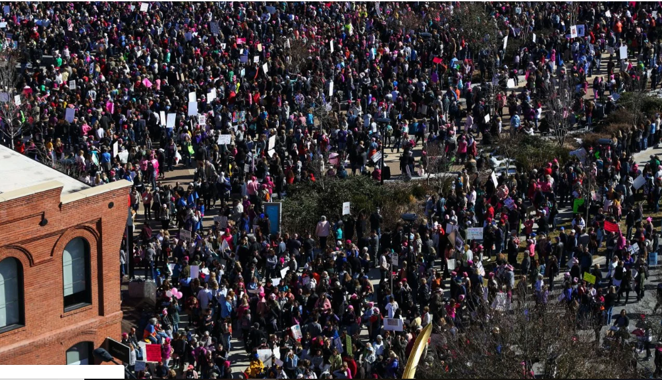
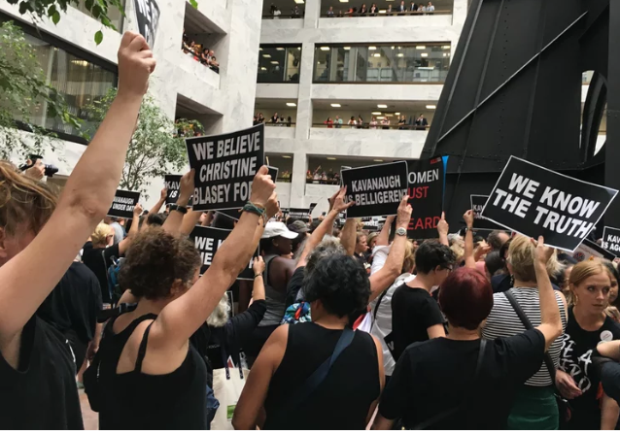
How has the League Changed in the Past 100 Years?
Now
In 2019, Women gather on the streets of D.C. and on the steps of SCOTUS

Slide 7
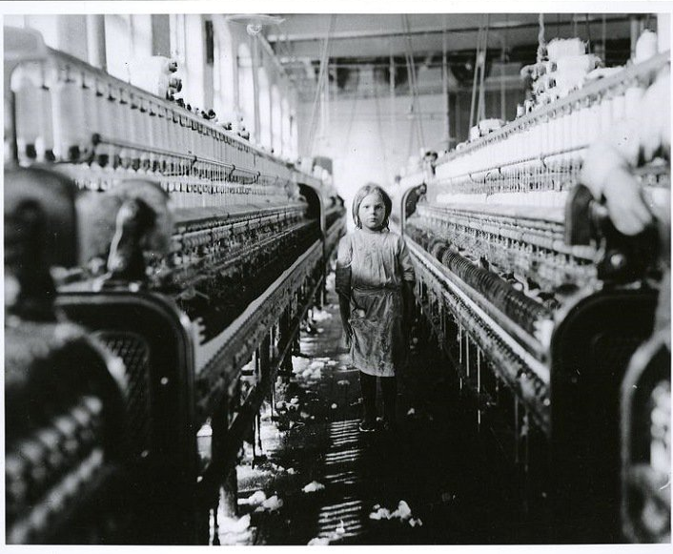
How has the League Changed in the Past 100 Years?
Then – Child Labor
1909: First issue for inspiring interest in women’s suffrage: child labor issues after learning of children who worked in cotton mills were dying at ages 8 to 12 because of lint in mills.
Now

Slide 8
How has the League Changed in the Past 100 Years?
Now – Children’s Issues
Child Care - Support programs and policies to expand the supply of affordable, quality child care for all who need it
Early Intervention for Children at Risk - Support policies and programs that promote the well-being, development and safety of all children
Violence Prevention - Support violence prevention programs in communities
And more - Bullying, safety at schools, social media exploitation,...

Slide 9
How has the League Changed in the Past 100 Years?
Then
In 1909, the very idea of women voting contradicted the traditional role of men and women in society. More critical in Virginia, where the ESL worked for a state suffrage amendment, was the fear that giving the vote to women would lead to black women voting which would upset the balance of power in Virginia and throughout the South.
Now: (Guess they were right.)

Slide 10
How has the League Changed in the Past 100 Years?
Now
Guess they were right!
1983 – Yvonne B Miller, the first African-American woman to be elected to the state house. Four years later, she was elected to the state Senate, and was consistently reelected after that, died in office in 2012.

Slide 11
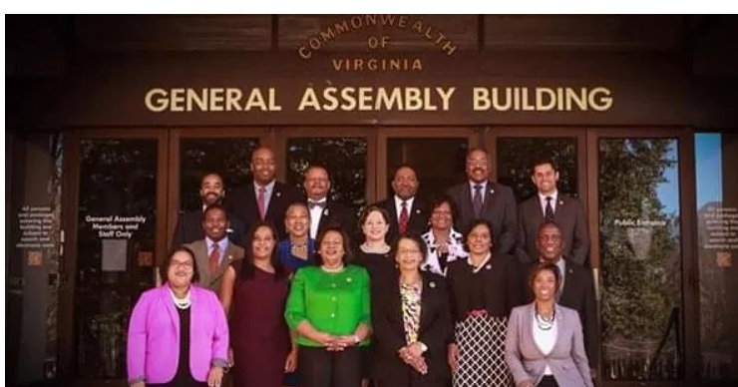
How has the League Changed in the Past 100 Years?
Now
The Virginia Legislative Black Caucus

Slide 12
How has the League Changed in the Past 100 Years?
Then
Then (1950s): White Virginia women supported school segregation
Now

Slide 13
How has the League Changed in the Past 100 Years?
Now
The African-American heroine of desegregation, Barbara Johns, is honored with a statue on Capitol Square in Richmond. (See LWV-VA Positions re equity in education.)

Slide 14
How has the League Changed in the Past 100 Years?
Then
Now

Slide 15
How has the League Changed in the Past 100 Years?
Then
Now

Slide 16
How has the League Changed in the Past 100 Years?
Then
Now

Slide 17
League Pamphlet - 1919
The Aims of the League
The organization has three purposes:
to foster education in citizenship,
to promote forums and public discussion of civic reforms and
to support needed legislation

Slide 18
LWV-VA 2018
MISSION STATEMENT: Empowering Voters. Defending Democracy.
VISION STATEMENT: We envision a democracy where every person has the desire, the right, the knowledge and the confidence to participate.
VALUE STATEMENT: We believe in the power of women to create a more perfect democracy.

Slide 19
What is the Prince William League Doing?
We are busy!
  Participate in voter registration and education opportunities
  Organize candidate forums
  Partner with other groups to present programs (DST, PWC100)
  Visit Jails to explain Restoration of Rights
  Attend Electoral Board meetings, BOCS meetings
  Organized and participated in several Opioid Awareness programs, partnering with other organizations
  Organized ERA program with local delegates attending
  Developed a task force to study School Choice – 2017-18

Slide 20
Today’s Issues for the LWV-VA
Behavioral Health
Education/School Choice
Felon Voting Rights
Firearm Safety
Fracking, Uranium & other Extractive Industries
Human Trafficking
Redistricting in Virginia
Voter Advocacy
Women’s Issues: Women’s rights and the VA Code
Most of these are active Facebook Groups.

Slide 21
Today’s Issues for LWV-PWA
Women’s Issues – ERA, human trafficking, reproductive rights, sexual harassment
Redistricting/Gerrymandering
Election Issues
  Voting rights, voter suppression
Environmental Issues – fracking, pipeline, coal ash
Immigration
Firearm Safety
Ranked Choice voting
All of these issues are supported by the US and VA Leagues

Slide 22
What is the Prince William League Doing?
We study and learn the issues – and then we take action and advocate
Action and Advocacy are based on the League positions, or platforms. As League members we must be nonpartisan. As individuals (not as members) we are able to choose sides.
Statewide positions we have taken part in:
  Fracking study and consensus process
  School Choice Task Force – updating a state position
  Redistricting – community education and advocating for change with our legislators, working with OneVirginia2021
  Advocacy and lobbying for passage of the ERA

Slide 23
How do we learn about the Issues?
League workshops
League position papers on issues
General meetings with speakers who are advocates for issues that we support
Study groups that research the issues and report findings
Smaller groups that base book discussions or movie presentations on a particular issue. Latest issue is behavioral health – opioid addiction in PWC
Candidate Forums – always non-partisan, learn what the candidates stand for – or against
Our “Observer Corps” –attend government meetings

Slide 24
What is the Prince William League Doing?
We study, learn, take action and advocate
Local action and advocacy based on the National and State positions:
Lobbying PW BOS to support No Excuse Absentee Voting by setting it as one of its legislative priorities. They did.
Lobbying PW BOS to support ERA resolution. They did not.
Restoration of Rights education for inmates
Ban the Box advocacy – approved by BOS for county agencies
Homeless issues, school discipline issues – supported community education on these topics, worked with community groups

Slide 25
What is the Prince William League Doing?
Voting and Voter Education
LWV-PWA has a long history of working to educate voters and encouraging people to register:
Voter registration drives with Electoral Board confidence*
They Represent You (TRY) – We create brochures with lists of PWC representatives and contact information
TOP TEN – lots of information on a small page all about elections
Candidate debates, often with partner organizations
Electoral board meetings - “Observer Corps”
*Members wishing to take part in Voter Registration Drives must take a course given by the VA Board of Elections and register with them each year.

Slide 26
What can you do as a Member of the League?
Get Informed and Speak Out
Promote voter registration and education – through high schools, community colleges, others
Provide community Voter Service –distribute They Represent You (TRY) brochures to community
Speak out on local, state and national issues
Attend meetings and discuss issues
Write letters to the editor, advocating for League position on the issues
  You must write as an independent citizen, only the President can speak for the League.

Slide 27
What can you do?
Be Active – Engage in Advocacy
As a Member of the League of Women Voters
Know who your representatives are and where they stand on the issues
Attend the Women’s Legislative Round Table in Richmond, to get informed on upcoming issues, and,
Advocate for your positions to your representatives in PWC, VA or DC
Take Action when Action Alerts come out from the State League

Slide 28
What can you do?
Go Local
Register to vote and Vote!
Participate in voter registration in high schools or civic events
Volunteer to take voters to register, or to absentee voting, or to the polls on Election Day
Attend School Board, Board of Supervisors or the Electoral Board meetings – learn what’s going on, report back
Take part in activities sponsored by our PWA League

Slide 29
1920 to 2020
100 years - how far have we come?
Would our early sisters say that we have worked hard enough, or point to what is left to accomplish?
How will we mark this anniversary?
What will we do to honor all of those members who worked so hard to get us where we are today?

Slide 30
“Democracy Dies in Darkness”
(Washington Post masthead)
Let’s continue to keep the lights on.

