Slide 1
LEAGUE OF WOMEN VOTERS®
Trusted Community Leadership since 1920
The Basics of the League
1

Slide 2
League Basics
What is League structure?
What does it stand for? Its mission?
How does it arrive at its positions?
How does it get its funding?
What is the difference between the League and the League Education Fund?
What exactly is VOTE411?
2

Slide 3
League Structure
The League of Women Voters of the US®
State Leagues (50+DC+)
The League of Women Voters of VA
Local Leagues (700+)
The League of Women Voters of Prince William and Fauquier Area
ILOs - Interleague organizations (3+)
National Capital Area
3

Slide 4
Structure of the LWVUS
50 States, DC, 2 overseas, and ILOs
State
VA
State
MD
League of Women Voters
US
ILO
NCA
DC
Question: where are the 2 overseas chapters?

Slide 5
LWV US Role In League Structure
The US League of Women Voters® has chapters in the 50 states, DC and Hong Kong and the US Virgin Islands
Yes, there is a Hong Kong chapter devoted to Americans overseas!
5

Slide 6
LWV VA Role In League Structure
The VA State League of Women Voters® has 16 leagues
14 chapters and
2 State Affiliates
LWV of Middle Peninsula
LWV of Peninsula
Question: How many Leagues are there in total?
6

Slide 7
League of Women Voters of Prince William-Fauquier Area
League of Women Voters of Roanoke Valley

Slide 8
LWV-PWFA
The League of Women Voters®
Prince William-Fauquier Area
(our Name since 2021)
encompassing Prince William and Fauquier Counties, and the cities of Manassas, Manassas Park, and
Warrenton
8

Slide 9
ILOs
Interleague organizations (ILOs) can be surrounding counties or states. They unite because of similar concerns.
Question: - How many Inter League Organizations (ILOs) are there in the US?
9

Slide 10
ILOs
There are 3 Inter League Organizations in the US at present.
Twin Cities, Minn. (CMAL)
Upper Miss. River Region (UMRR)
National Capital Area (NCA) We belong!
10

Slide 11
LWVNCA
Leagues making up the LWNCA
District of Columbia League
Maryland: Frederick County, Howard County, Montgomery County and Prince George's County
Virginia: Arlington County & Alexandria City, the Fairfax Area, Falls Church City, Loudoun County, and Prince William-Fauquier Area.
11

Slide 12
LWV Mission, Vision and Value
Mission
Empowering voters. Defending democracy.
Vision
We envision a democracy where every person has the desire, the right, the knowledge and the confidence to participate.
Value
We believe in the power of women to create a more perfect democracy.
Diversity, Equity and Inclusion
We strive to achieve greater equity and inclusion within the League through all we do.
12

Slide 13
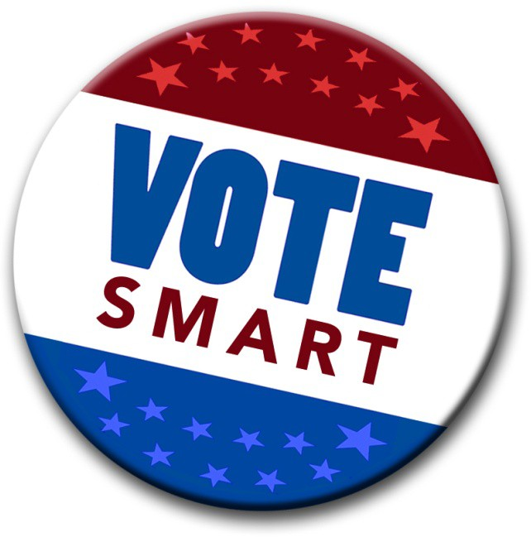
LWV Mission
We do not support or oppose any candidates for office or political parties. (very important, even if hard to do.)
We want everyone to vote so our elected leaders represent our entire community.
We are a voice for all, working to connect people directly with government.
We provide and work from facts. We educate. We advocate for change.

Slide 14
LWV Roles
The League of Women Voters has two separate and distinct roles.
Voters Service/Citizen Education: we present unbiased, nonpartisan information about elections, the voting process, and issues. To conduct our voter service and citizen education activities, we use funds from the League of Women Voters of Virginia Education Fund, which is a 501(c)(3) corporation, a nonprofit educational organization.

Slide 15
Our Roles
The League of Women Voters has two separate and distinct roles.
Action/Advocacy: we are nonpartisan, and, after study, we use our positions to advocate for or against particular policies in the public interest. The League of Women Voters, is a nonprofit 501(c)(4) corporation.

Slide 16
How do we decide what policies to pursue and what positions to take?
League Policies and Positions

Slide 17
National Positions are arrived at by studying issues. Voting on each of the studies takes place during the biennial convention. If they are accepted, they become positions. Advocacy can then be taken on the particular issue addressed by the position. Without an official position, action/advocacy cannot be taken in LWV’s name.
League Position Statements
National

Slide 18
League of Women Voters® of Virginia

Slide 19
LWV of Virginia
We advocate on statewide issues after carefully researched study and development of positions with membership input.
We provide non-partisan voter guides, candidate and issue forums, Legislative Directories, information about voting laws and practices and studies about public issues.

Slide 20
LWV of Virginia
We have two separate and distinct roles:
Voters Service/Citizen Education: we present unbiased nonpartisan information about elections, the voting process, and issues.
Action/Advocacy: we are nonpartisan, and, after study, we use our researched positions to advocate for or against particular policies in the public interest.
We are a nonprofit 501(c)(4) corporation.

Slide 21
League of Women Voters of the Prince William-Fauquier Area
Serving the Counties of Prince William and Fauquier, and the cities of Manassas and Manassas Park

Slide 22
LWV – Prince William-Fauquier Area
The Prince William Area League was founded in May 2007 from the Fairfax League, to serve Prince William County and the included cities. In 2021 the name change was approved to recognize Fauquier County, which is one of our quickest growing areas.
We started with 27 members, and now have 93.

Slide 23
What is the Prince William-Fauquier Area League Doing?
We study and learn the issues – and then we take action and advocate
Action and Advocacy are based on the League positions. As League members we must be nonpartisan. As individuals (not as members) we are able to choose sides.
Statewide positions we have taken part in:
Redistricting – community education and advocating for change with our legislators, working with 1VA2021
Updating Election Laws
Affordable Housing

Slide 24
Prince William-Fauquier Activities Action and Advocacy
Remain in contact with both our state and federal senators and representatives to inform them of the LWV position on issues
Participate, along with members from around the state, in strategy sessions and the Women’s Legislative Roundtable (WLRT) during the General Assembly legislative sessions
Observe Senate and House caucuses

Slide 25
Prince William-Fauquier Activities We encourage Voting
Conduct voter registration events in churches, synagogues, festivals and fairs, high schools and community colleges
Collaborate with the PWC-100 and other civic groups to conduct candidate forums
Co-sponsor weekly Black Lives Matter vigils
Educate voters on important things to know before voting (Top Ten cards)

Slide 26
Prince William-Fauquier Activities We encourage Voting
Aid residents of rehab facilities and senior centers to apply for absentee voting
Update www.vote411 – a site to learn about the candidates, and develop campaigns to inform voters of its importance
Distribute rack cards in 5 languages (Arabic, Mandarin, Vietnamese, Korean and Spanish) to voters to learn about the www.vote411 website, and encourage them to vote

Slide 27
www.VOTE411
www.VOTE411 is our one-stop-shop for election-related information. It provides nonpartisan info to the public. They can register to vote, find candidate information, and much more.
VOTE411 is sponsored and has been developed by the US LWV but depends on local leagues to update its candidate database.
27

Slide 28
How does the League Finance itself? Dues and Grants
The League (US, VA, LWV-PWFA) depends on our dues. The dues that we pay is split between the 3 tiers. We also depend on grants and donations.
Grants are usually given for our work in creating VR materials or helping with the VR process. They come from the State and US League, foundations and corporations.
28

Slide 29
How does the League Finance itself? Donations
Donations can be made through our league to the League of Women Voters Education Fund (LWVEF), a 501(c)(3) organization.
Gifts support our work to register voters and provide voters with election information through voter guides as well as candidate forums and debates.
29

Slide 30
Prince William-Fauquier Activities
Prepare and disseminate voter information (Top Tens, They Represent You (TRY)
Conduct voter registration, registering new citizens and residents, many for the first time
Meet personally with legislators in Richmond
Observe local BOCS , Electoral Board, and other meetings (Observer Corps)
Participate in a variety of conferences to better prepare our members to address critical issues

Slide 31
Voter Information from LWV-PWFA
We work to register voters at many public events as well as through the local high schools and senior centers.
We provide citizens with voter guides such as Top Tens, (what you need to know and where to find it, before you vote), and VOTE411 information .
We host and co-host with local organizations candidate forums and debates.
31

Slide 32
Why Should I Join the League of Women Voters?
Are you interested in fairness in elections?
Are you distressed by the feeling that you are helpless to change things today?
Are you frustrated that people complain about the way things are but do not want to do anything about it?
Do you feel that very few people care about what’s going on in our County or State or Nation?
Do you feel that very few people know how our government works?
Does it upset you that people don’t know who their candidates are, or what they stand for?
Then the League of Women Voters is the place for you.

Slide 33
What Can You Do?
Learn how government works, how bills are introduced and become laws, and what role you can play in that process
Learn who your federal and state legislators are and what they stand for; learn who your local government officials are – all politics is local
Be in touch with your legislators; go to their community meetings; stop by their offices to visit and tell them what’s important to you

Slide 34
What Can You Do?
Participate in voter registration in high schools or civic events
Volunteer to take voters to register, or to absentee voting, or to the polls on Election Day
Attend School Board, Board of Supervisors, Electoral Board meetings or other government commission meetings – learn what’s going on, report back as part of the Observer Corps

Slide 35
Contact Us
League of Women Voters® Prince William-Fauquier Area
www.princewilliamlwv.org
www.facebook.com/LWVPWCA
lwvpwfa@gmail.com

