Slide 1
2023 Legislative Session: Before & During
Lisa R. Varga, MLS, Executive Director, Virginia Library Association

Slide 2

How did we get here?
2013: Laura Murphy, Fairfax, wants Beloved off the AP English 12 reading list
2016 & 2017: Versions of the Beloved bill make their way through the VA General Assembly and are passed to Governor McAullife, who vetoes them
2021 VA election: Education is back on the table, and Mrs. Murphy reappears in ads on Twitter for now-Governor Youngkin.

Slide 3
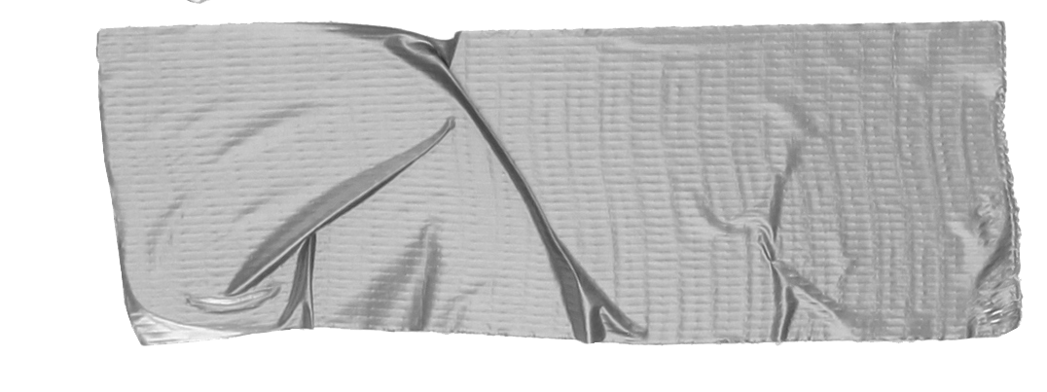

2021/2022
School Board Meetings across the US
Out of Context
Community members start showing up and reading out of context passages from books.
Emotional
The out of context information creates chaos at meetings
Factually incorrect
Claiming books are pornographic or obscene, suggesting librarians and educators are grooming and indoctrinating children.

Slide 4
What is the Virginia Library Association?
Represent 5,000+ Librarians, library staff and library supporters at public and academic libraries in Virginia
Separate from VAASL, the Virginia Association of School Librarians
A chapter of the American Library Association

Slide 5
Lawsuit in Virginia Beach, May 2022
Delegate Tim Anderson files suit in VB Circuit Court on behalf of Tommy Altman, who is running for the Republican Congressional nomination
for the VA-02
Suits are against the authors, publishers and distributors of Gender Queer by Maia Kobabe and A Court of Mist and Fury by Sarah J. Maas

Slide 6
Pornography and Obscenity, Miller v. California (1973)
When evaluating a work, the ENTIRE work must be evaluated before the item can be called pronographic or obscene.

Slide 7
Hearing in Virginia Beach: August 2022
Judge Pamela Baskerville vacates the petitions against the books, publishers and booksellers and finds that the piece of VA Code Anderson used to file was unconstitutional
Tip
ALWAYS activate your networks. No one should go through this alone.

Slide 8
At the same time:
VA Beach School Board member Vicky Manning is filing reconsideration requests – 16 of them.
Anderson does a Freedom of Information Act request for the names of the librarians at the schools where books he deems “offensive” can be found.
Educators are threatened online (“She should be stoned to death.”)
School Board meetings around Virginia continue to heat up under the guise of “parental control.”

Slide 9

Where are we now?
A lot of bills related to education
Some that impose on intellectual freedom
Others encouraging Charter Schools
Urging “educational transparency”
General Assembly 2023
Started January 11
Ends February 25
1500+ bills were proposed this week

Slide 10
Ratings Systems
Voluntary
Tied to distribution of the material
Not legally enforceable

Slide 11
Tracking Bills
Legislative Information Service (LIS) : https://lis.virginia.gov/
Who Is My Legislator? https://whosmy.virginiageneralassembly.gov/
VLA’s One Click Politics: https://oneclickpolitics.global.ssl.fastly.net/messages/edit?promo_id=17914

Slide 12
Bills on our radar:
HB1379 https://lis.virginia.gov/cgi-bin/legp604.exe?231+sum+HB1379
HB1448 https://lis.virginia.gov/cgi-bin/legp604.exe?231+sum+HB1448
HB1803 https://lis.virginia.gov/cgi-bin/legp604.exe?231+sum+HB1803
HB1903 https://lis.virginia.gov/cgi-bin/legp604.exe?231+sum+HB1903
HB1708 https://lis.virginia.gov/cgi-bin/legp604.exe?231+sum+HB1708
SB 1204: https://lis.virginia.gov/cgi-bin/legp604.exe?ses=231&typ=bil&val=sb1204
Others of interest:
HB2349: https://lis.virginia.gov/cgi-bin/legp604.exe?ses=231&typ=bil&val=hb2349
HB2136: https://lis.virginia.gov/cgi-bin/legp604.exe?231+sum+HB2136

Slide 13

SB787
Passed by Indefinitely by the Senate Subcommittee on Public Education on Thursday
It is not officially dead, but it coming back is slim.

