Slide 1
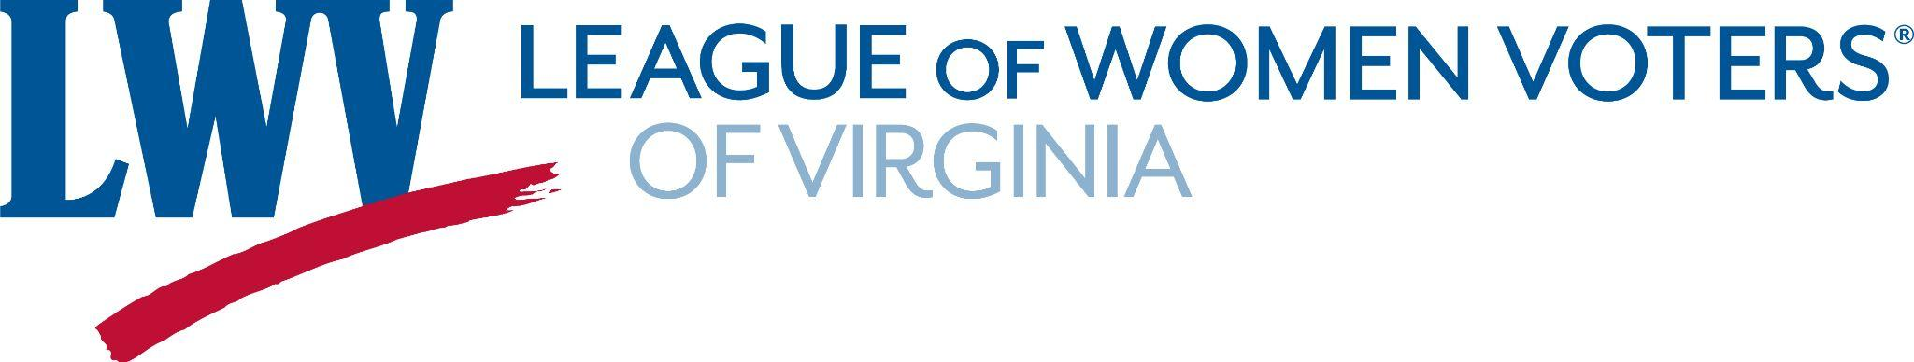
Recommended Program
Inalienable Right to Vote
Notes:
Definition from Google search; Oxford Languages: Inalienable: unable to be taken away from or given away by the possessor

Slide 2
Study Committee
Arina van Breda and Deb Wake (Fairfax)
Carolyn Caywood (South Hampton Roads)
Chris DeRosa, Lisa Koteen Gerchick, and Liz Scheffler (Arlington/Alexandria)
Karen Siracusa, Linda Rice, Pat Black-Evers (Williamsburg)
Shirley Everett (Roanoke)

Slide 3
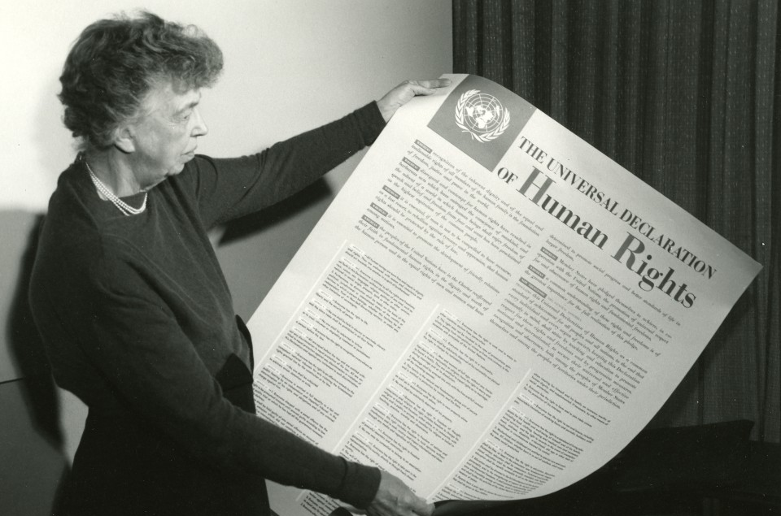
Whereas recognition of the inherent dignity and of the equal and inalienable rights of all members of the human family is the foundation of freedom, justice and peace in the world," –United Nations Declaration of Human Rights (1948, December)
“Democracy arises from people’s desire for dignity, equality, justice, liberty, and participation— their desire for a voice.” -- Carter Center and United Nations Human Rights Office. (2017, December)
Notes:
Eleanor Roosevelt, a prominent LWV member, chaired the United Nations Human Rights Committee.
Your voice is your vote.

Slide 4
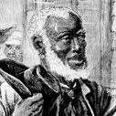




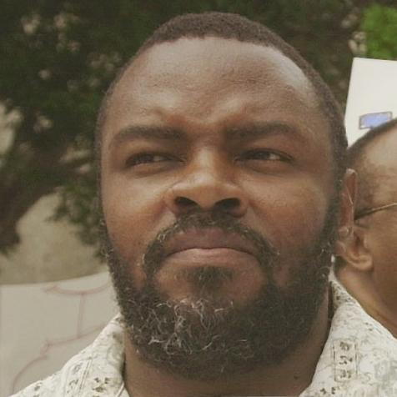
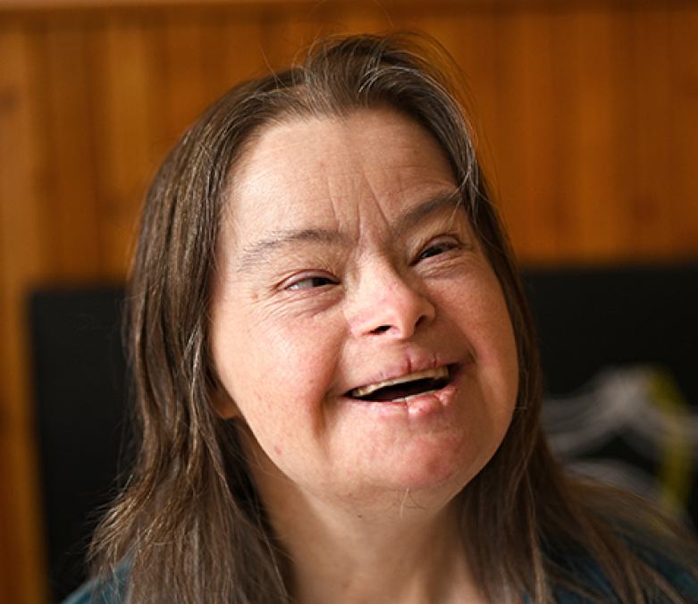
Discrimination
Discrimination: “the unjust or prejudicial treatment of different categories of people, especially on the grounds of ethnicity, age, sex, or disability.”-- Oxford Languages
They lack the capacity to understand voting.
They will be unduly influenced by others on how to vote.
The purity of the vote should not be sullied by them.

Slide 5
Study Purpose and Aspirational Goals
Too often treated as a privilege, the League believes voting is a right. This study examines the history and underpinnings of the concept of the right to vote and how this is an inherent right belonging to those living in a democracy. In particular, it focuses on those disenfranchised in the Virginia Constitution: those under the age of 18, those with a felony conviction, those who have been mentally adjudicated as incompetent.
Aspirational Goals:
Protected Right to Vote
Permit those 16 & 17 years of age to vote in local and state elections
Those who commit a felony do not lose their right to vote and can vote in prison
Those who indicate desire to vote should be allowed, despite guardianship
Changes in Virginia Constitution:
  Add a “fundamental right to vote” clause in both the title and body of Section 1.
  Permit those who are 16 and older to vote in local and state elections.
  Remove the stipulations in Section 1, Article II of the Virginia Constitution that disenfranchise citizens convicted of a felony and those adjudicated to be mentally incompetent.
Notes:
Local League supporting the Study Proposal include Arlington/Alexandria, Falls Church, Lynchburg, Montgomery County, Prince William/Fauquier, Roanoke Valley, South Hampton Roads, and Williamsburg. Seven League members have volunteered for the Study.

Slide 6
LWVUS positions
Current positions: https://www.lwv.org/sites/default/files/2023-02/LWV_ImpactOnIssues2022-2024.pdf
Under League Principles…The League of Women Voters believes every citizen should be protected in the right to vote… (p. 10)
…massive systemic reforms needed to protect and improve our democracy. These reforms include preventing barriers to the ballot box, ending felony disenfranchisement… (p. 22)

Slide 7
Retain LWV-VA positions
Current position: https://my.lwv.org/sites/default/files/lwv_va_positions_full_2023.pdf
The League of Women Voters of Virginia believes that democratic government depends on the informed and active participation of its citizens; that voting is a right and responsibility. (p. 5)
The League of Women Voters of Virginia:
opposes land ownership or literacy as requirements to vote. (p. 6)
opposes measures that seek to infringe on this fundamental right or create barriers to voters casting ballots. Voter suppression efforts can include but are not limited to: manipulation of the registration process; policies that make voting difficult, time consuming or dangerous; felon disenfranchisement; and disinformation that confuses voters or discourages them from casting their vote. (p. 11)
The procedure should be identical for all felons regardless of the nature of their crime (p.44)
Notes:
(p. 6): In 1965, the League arrived at a position in opposition to the Freeholder Amendment to the Virginia Constitution, which would have limited voting on bond issues to property owners. Virginia had come under Section 5 of the Federal Voting Rights Act in 1965 because the state had a literacy requirement and less than 50% of its voting age population had voted in the 1964 presidential election. The League modified its position in 1967 to seek elimination of the literacy requirement, calling instead for some other means of identification for those unable to sign

Slide 8
Federal laws
The U.S. Constitution and Voting Rights
Under Article 1, Section 2 of the U.S. Constitution, the states were vested with the authority to determine who should vote, and the related “times, places and manner” under which this right should be exercised.
Subsequent Amendments including the 14th, 15th, 19th, 24th and 26th, further defined the states’ authority. The 14th and 15th Amendments, along with the 13th Amendment, are commonly referred to as the Reconstruction Amendments and focus on: the abolishment of chattel slavery (13th); equal protection under the law (14th); and male suffrage without regard to prior enslavement or African descent (15th). Post Reconstruction, the 14th and 15th Amendments were not enforced.
Notes:
Our focus is on WHO can vote rather than the mechanisms of voting. Originally, only white, land-owning males aged 21 or older could vote

Slide 9
Federal laws (continued)
The 19th Amendment (1920)—Women's Suffrage
The 1965 Voting Rights Act (1965)
  Pre-clearance; Shelby Co. v. Holder (2013) and Brnovich v. DNC (2021)
The 26th Amendment (1971)—Lowering the Voting Age from 21 to 18
The 24th Amendment (Removal of Poll Taxes) (1964) & The National Voter Registration Act (NVRA) (aka Motor Voter Act) (1993)–widespread voter registration
Uniformed and Overseas Citizens Absentee Voting Act (UOCAVA) (1986)--absentee voting
Americans with Disabilities Act (ADA) (1990)--ensures full and equal access to voting
The Help America Vote Act (HAVA) (2002)--minimum standards for states to conduct elections
Notes:
“The LWV-VA was jubilant at the demise of the poll tax at long last. The League and others mounted massive voter registration drives which frequently resulted in registrars being swamped. During this time, registrars could only register voters at their offices, they could not leave to do so. However, neighborhood registrars could be appointed to register voters from their homes and the League actively participated as neighborhood registrars or assisted in identifying these auxiliary registrars. This led to huge increases in voter registration.” update to Colvard history of LWV-VA
Native American Voters
- Underrepresented communities including Native Americans and other minority communities are often excluded from consideration of the impact of voting laws.
- Special considerations for the unique circumstances (eg, poor or non-existent public infrastructure such as roads or mail delivery) of minority communities should be weighed when laws are promulgated.
- The history of racial discrimination can be found in many of our existing laws and practices regarding voting. The loss of federal protection once afforded by the VRA has adversely impacted many voters throughout the country.
Asian Voters
Congressional actions created roadblocks to immigration and citizenship; these roadblocks impacted the voting rights of immigrants from Asia and Americans of Asian ancestry
Naturalization Act of 1790 was one of the first Congressional actions – it limited citizenship to “any alien, being a free white person”
Voting Rights Act of 1965 outlawed barriers to voting (that had been used to disenfranchise minority voters)

Slide 10
VA Constitution Article II, Section 1, Qualification of Voters
Virginia drafted the 1901-1902 state constitution and supporting legislation with the intent to disenfranchise Blacks despite the 14th Amendment to the U.S. Constitution. The passage of the 24th Amendment and the 1965 Voting Rights Act necessitated Virginia to rewrite its constitution, resulting in the 1971 Virginia Constitution, under which we currently operate.
https://law.lis.virginia.gov/constitution/article2/section1/
In elections by the people, the qualifications of voters shall be as follows: Each voter shall be a citizen of the United States, shall be eighteen years of age, shall fulfill the residence requirements set forth in this section, and shall be registered to vote pursuant to this article. No person who has been convicted of a felony shall be qualified to vote unless his civil rights have been restored by the Governor or other appropriate authority. As prescribed by law, no person adjudicated to be mentally incompetent shall be qualified to vote until his competency has been reestablished…

Slide 11
Virginia Laws
Virginia Voting Rights Act (VA VRA) (2021)–prohibits different standards or practices from being applied to a voter “based on his race or color or membership in a language minority group” and prohibits “at large” methods of elections that would prevent minority voters from being able to elect a candidate of their choosing. In addition, localities are required to accept public comments and establish a waiting period before enacting a covered practice. The VA VRA also provides guidance for how affected individuals can seek relief.

Slide 12
Inalienable Right to Vote Study Contents
Discussion of Voting and Democracy (pp. 2-7)
What International, Federal and Virginia laws say about voting (pp. 7-13)
In depth look at three groups explicitly disenfranchised in Virginia’s constitution:
  16-17 year olds (pp. 13-18)
  Those with a felony conviction (pp. 18-31)
  Those mentally adjudicated as incompetent (pp. 31-36)
Conclusion (p. 36)
Consensus Questions (pp. 36-37)
Appendices: groups who won the right to vote:
  Women (pp. 37-46)
  18-20 year olds (pp. 46-48)
  Native Americans (pp. 48-50)
  Asian voters (pp. 50-51)
Resources cited (pp. 51-64)
Additional resources (pp. 64-70)

Slide 13
16-17 years-old
Cultivating a Voting Habit: Learning about elections in a supportive community (school/family) allows young voters to ask questions and become informed, developing a lifelong habit.
Skills and Knowledge: Learning about and participating in elections makes for more engaged and informed citizenry. Since the education is fresh, they may be better informed than many older adults. They have the capacity to understand complexities. 16 & 17 year-olds seek independence and the opportunity to participate as adults rather than as children.
Civic Education: Participation in elections fosters understanding of the process, promotes critical thinking, develops a better understanding of the importance of democracy, and provides an opportunity to learn the consequences of elections. Considering candidate platforms help young voters form their own values and priorities.
Younger Citizens are Not Adequately Represented: Policies with long-term consequences are made without the input of those most affected; ie. climate change, gun violence, healthcare, housing, education, debt accrual.

Slide 14
Felony Disenfranchisement
“Virginia broadened its list of disenfranchising crimes to include things like loitering, being homeless, even being unemployed.”
The 1971 Virginia Constitution does not mention the restoration of voting rights even though it was drafted to eliminate many of the Jim Crow laws put in place in 1901/1902. “Virginia [disenfranchises] all people with felony convictions even after they have completed their sentences and parole.”
“Since 1970, Virginia’s jail population increased 800%. Since 1983, the state’s prison population has more than doubled.”
In 2019, “Black people constituted 20% of state residents, but 53% of people in prison.” In 2023, “12% of voting-age Black Virginians [were] impacted. That’s more than 1 in 10 not allowed to vote.”
‘[Communities] where Black people had been kept from the ballot box before the Voting Rights Act are the same communities where Black people were incarcerated at higher rates after the Voting Rights Act.”
Notes:
Tough on crime policies increased the likelihood of incarceration

Slide 15
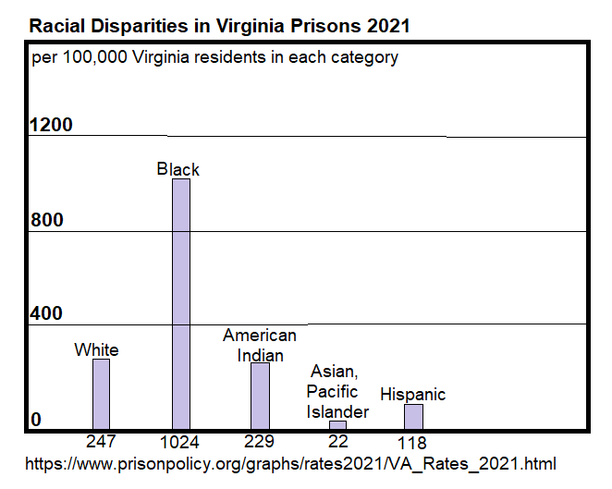

Slide 16
Mental Competence
Approximately 12,000 adult Virginians are disenfranchised, despite many of them having the capacity to understand the act of voting and a desire to vote, simply because a court has appointed a guardian for them.
A person under guardianship should retain the right to vote unless the individual cannot communicate, with or without reasonable accommodations, a desire to participate in the voting process.
A court considering guardianship should apply:
  a presumption that the right to vote is retained;
  a standard that does not exceed what is required of other voters;
  individually tailored accommodations consistent with Equal Protection and ADA requirements.
The mental capacity standard should be the capacity to understand the act of voting and a desire to vote.

Slide 17
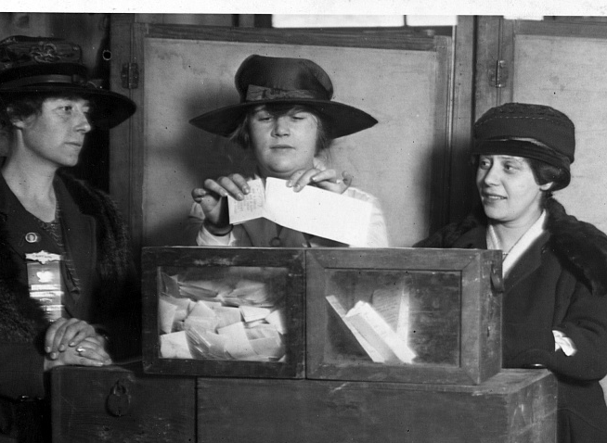
Purpose of Program
The League of Women Voters of VA is committed to protecting every citizen’s intrinsic right to vote!
League positions are for the long term.
If we believe in a principle, it doesn't matter whether today's political winds are unfavorable.
We go for the "moon shot."

Slide 18
Consensus Process
Questions are yes or no
Questions are not leading to a particular answer
Questions try to invoke thoughtful discourse
Questions try to get past personal bias
Questions help us discover where we have agreement and where we do not
Group discussion is important
Consensus is not voting
“The consensus process keeps us truly grassroots, but doesn’t risk the disgruntlement that plurality voting can create.“ -Carolyn Caywood

Slide 19
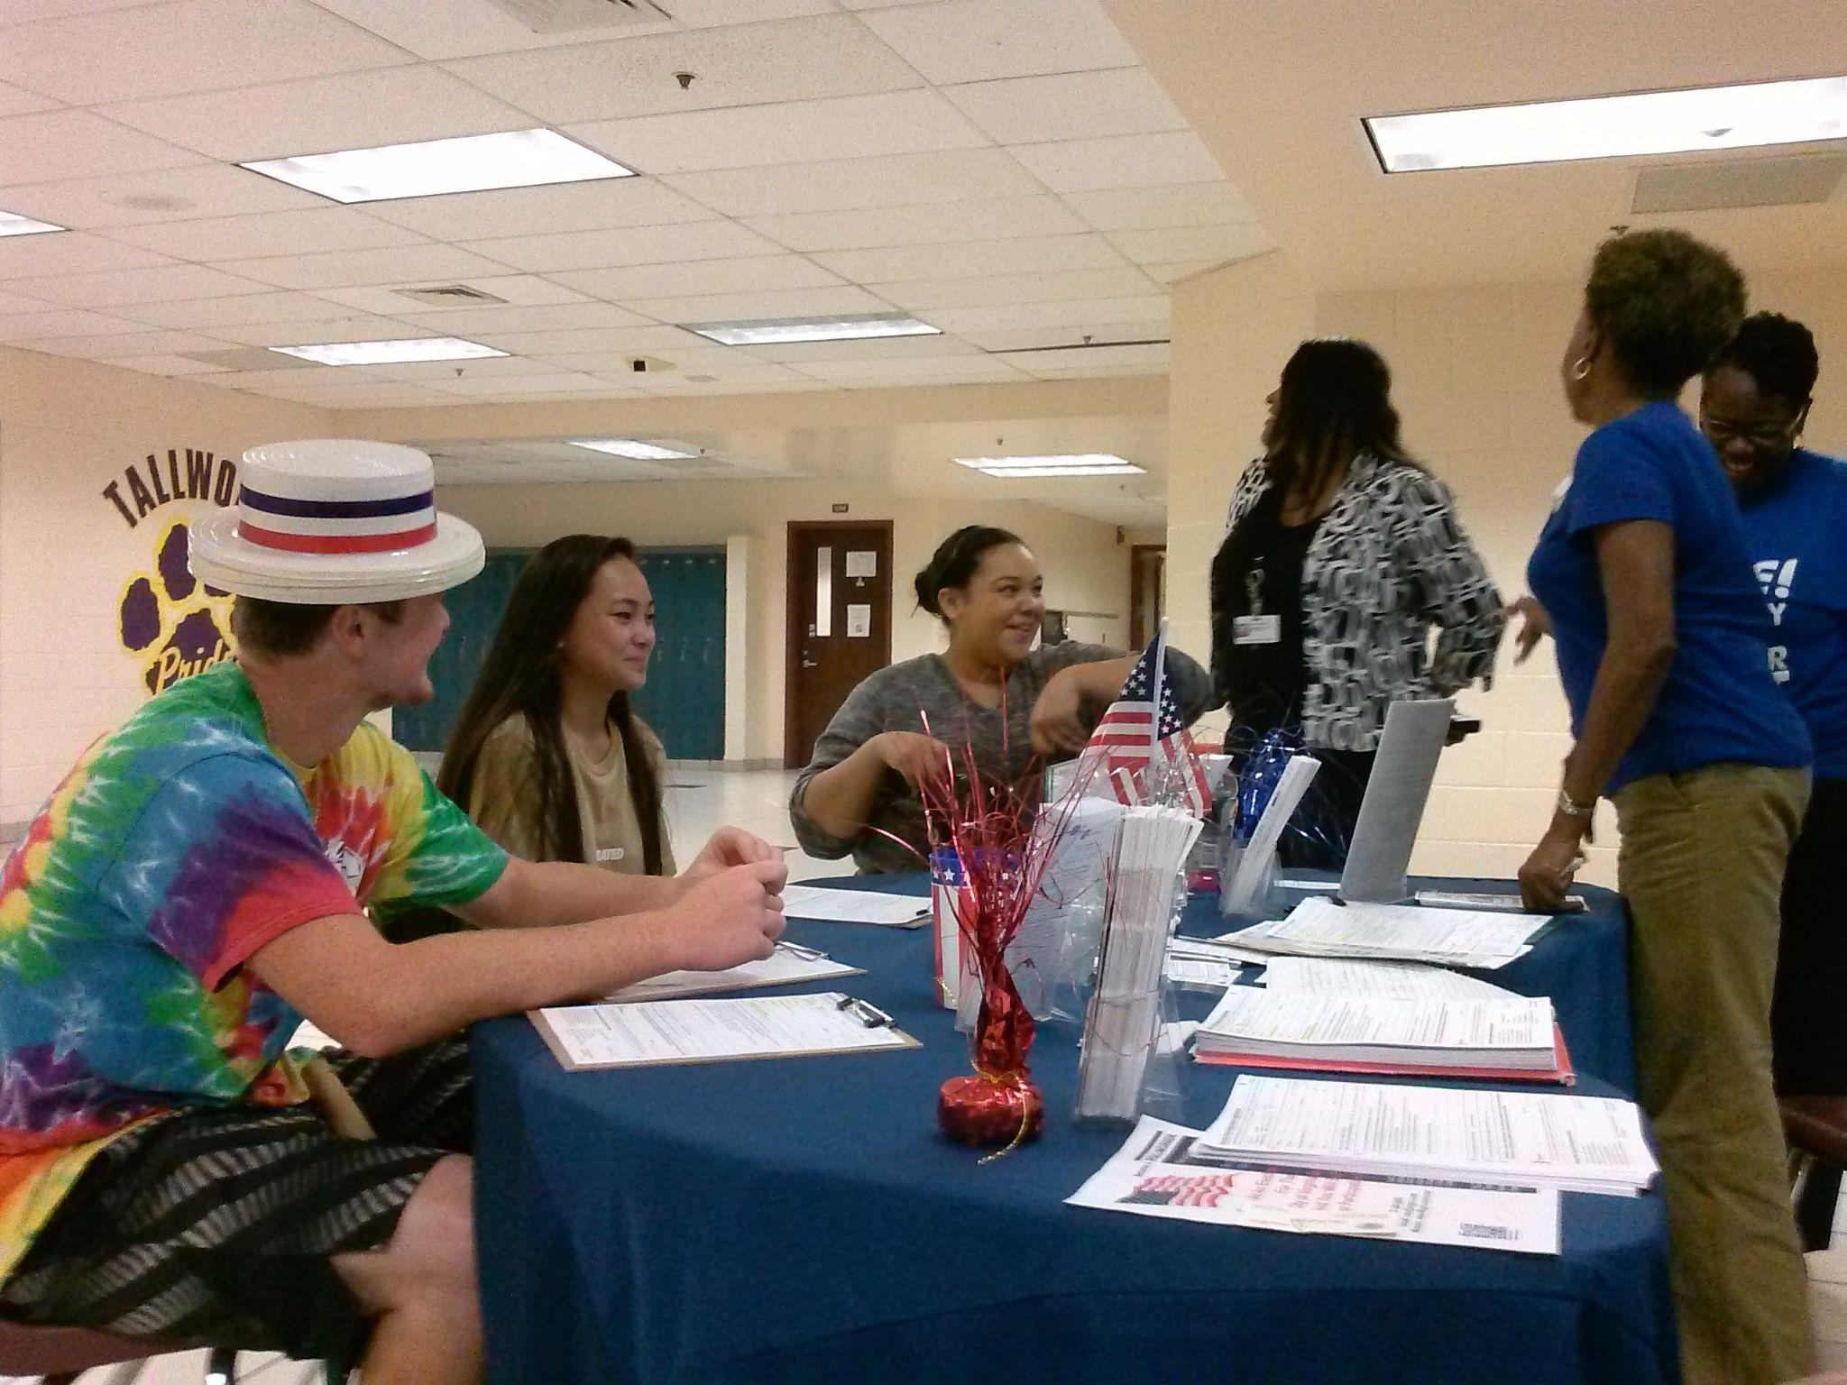

Slide 20
Consensus Questions
1. “Democracy arises from people’s desire for dignity, equality, justice, liberty, and participation–their desire for a voice.” If your voice is your vote, should everyone in a democracy have the right to vote?
Yes___ No___ No Consensus___. Comments:
2. The U.S. Constitution delegates to states the authority to decide who can vote, but amendments have expanded who can vote. Should the U.S. Constitution be amended to create one national standard for who can vote?
Yes___ No___ No Consensus___. Comments:

Slide 21
Consensus Questions (continued)
3. Should the Virginia Constitution be changed to add a “fundamental right to vote” clause in both the title and body of Section 1?
Yes___ No___ No Consensus___. Comments:
4. Should the Virginia Constitution be changed to permit those who are 16 and older to vote in local and state elections?
Yes___ No___ No Consensus___. Comments:
5. Should the Virginia Constitution be changed to remove the stipulations in Section 1, Article II of the Virginia Constitution that disenfranchise citizens convicted of a felony and those adjudicated to be mentally incompetent?
Yes___ No___ No Consensus___. Comments:

Slide 22
Consensus Questions (continued)
6. Given concerns over aging office holders and Supreme Court Justices, should there be an upper age limit to qualify to vote?
Yes___ No___ No Consensus___. Comments:
7. Should someone judged mentally incapacitated retain the right to vote if they demonstrate an understanding of the act of voting and a desire to cast a ballot?
Yes___ No___ No Consensus___. Comments:

